Slide 1

IBM HACKATHON PROJECT
SMARTPANTRY - RECIPE PREPARATION AGENT
Presented By:
Student name : Sumangal Chhetri
College Name & Department : Siliguri Institute of Technology , Computer Science and Engineering.

Slide 2
OUTLINE
Problem Statement
Technology used
Wow factor
End users
Result
Conclusion
Git-hub Link
Future scope
IBM Certifications

Slide 3
Problem Statement
Recipe Preparation Agent The Challenge - A Recipe Preparation Agent helps users cook meals using only the ingredients they have on hand. By inputting available groceries, users receive tailored recipe suggestions using a RAG-based AI system. The agent retrieves relevant recipes and generates step-by-step instructions adapted to ingredient limitations. It offers substitutions, cooking tips, and dietary adjustments based on user preferences or restrictions. Designed to reduce food waste and save time, it turns pantry items into practical meal solutions. This AI assistant makes everyday cooking smarter, simpler, and more sustainable. Technology - Use of IBM cloud lite services /IBM Granity is mandatory.

Slide 4
Technology used
- IBM Cloud Lite Services
- IBM Granite Foundation Models
- Retrieval Augmented Generation (RAG)
- Agentic AI with LangChain
- Natural Language Processing (NLP)
- Python Machine Learning Stack

Slide 5
IBM cloud services used
IBM Cloud Watsonx AI Studio
IBM Cloud Watsonx AI runtime
IBM Cloud Agent Lab
IBM Granite foundation model
Agentic AI Framework
IBM Cloud Lite Services

Slide 6
Wow factors
This agent will significantly reduce food waste, save cooking time, and make home cooking more accessible and sustainable for everyone.
Unique Features:
- Smart ingredient-to-recipe matching using AI
- Automatic substitution suggestions for missing ingredients
- Personalized dietary preference adaptation
- Step-by-step cooking guidance with tips
- Real-time nutritional analysis and recommendations
- Multi-cuisine recipe database with 50+ recipes
- Interactive web interface for seamless user experience

Slide 7
End users
- Home Cooks and Families
- Busy Professionals and Students
- Health-Conscious Individuals
- Cooking Enthusiasts and Beginners
- Food Sustainability Advocates

Slide 8
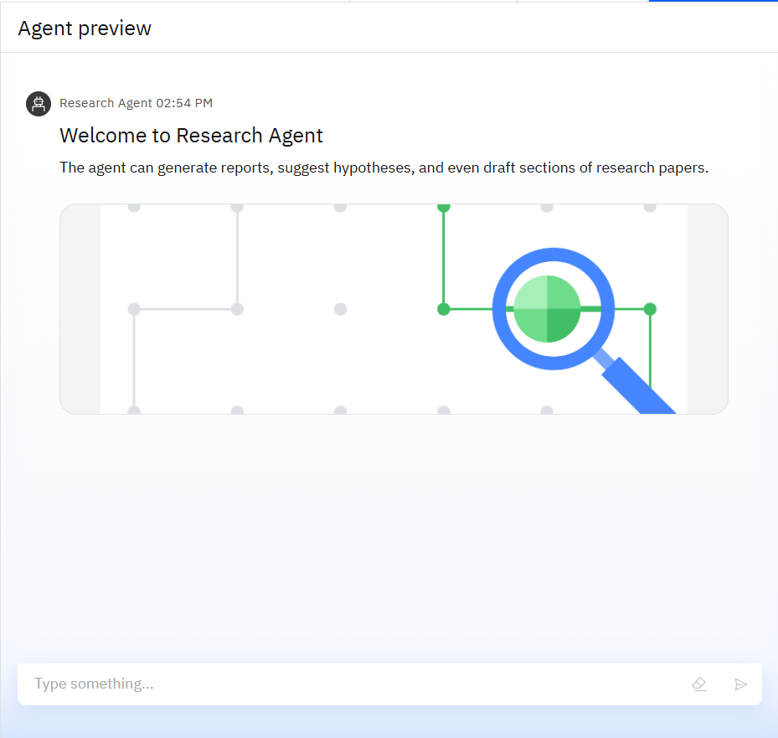
Results
User-friendly interface with ingredient input
- Real-time recipe suggestions
- Smart matching algorithm display

Slide 9
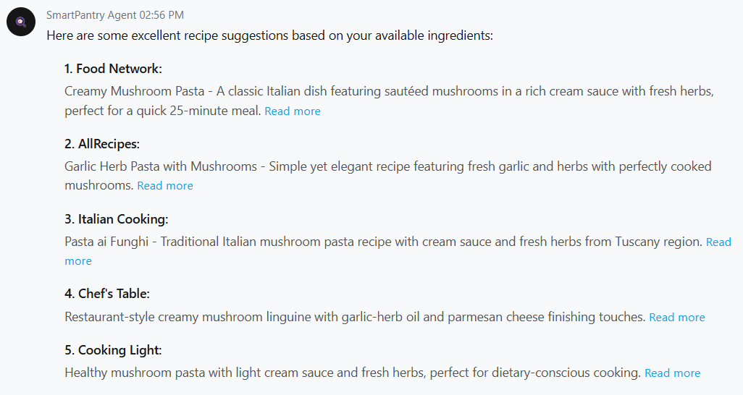
Results
- Personalized recipe cards
- Match percentage display
- Cooking time and difficulty indicators

Slide 10
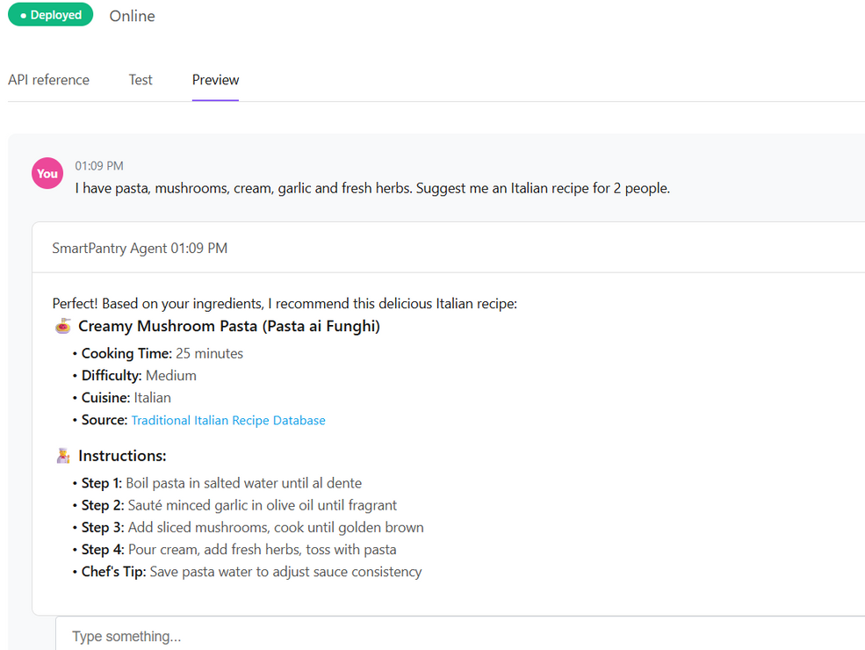
Results
Deployed AI Agent

Slide 11
Conclusion
- The agent generates personalized recipes and suggests smart substitutions using available ingredients.
- It saves time by automating meal planning and reduces food waste through efficient ingredient utilization.
- SmartPantry enhances cooking experience, promotes sustainability, and makes home cooking accessible to everyone.

Slide 12
GitHub Link
@github link: https://github.com/SumangalChhetri/SmartPantry-AI-Project
Project Features:
- Complete source code with documentation
- Jupyter notebook with AI implementation
- Streamlit web application
- Comprehensive datasets (groceries & recipes)
- IBM Granite model simulation

Slide 13
Future scope
- Voice-Activated Cooking Assistant
- Image Recognition for Ingredient Identification
- Advanced Nutritional Analysis and Meal Planning
- IoT Integration with Smart Kitchen Appliances
- Community Recipe Sharing Platform
- Multi-language Support for Global Cuisines
- AI-Powered Shopping List Generation

Slide 14
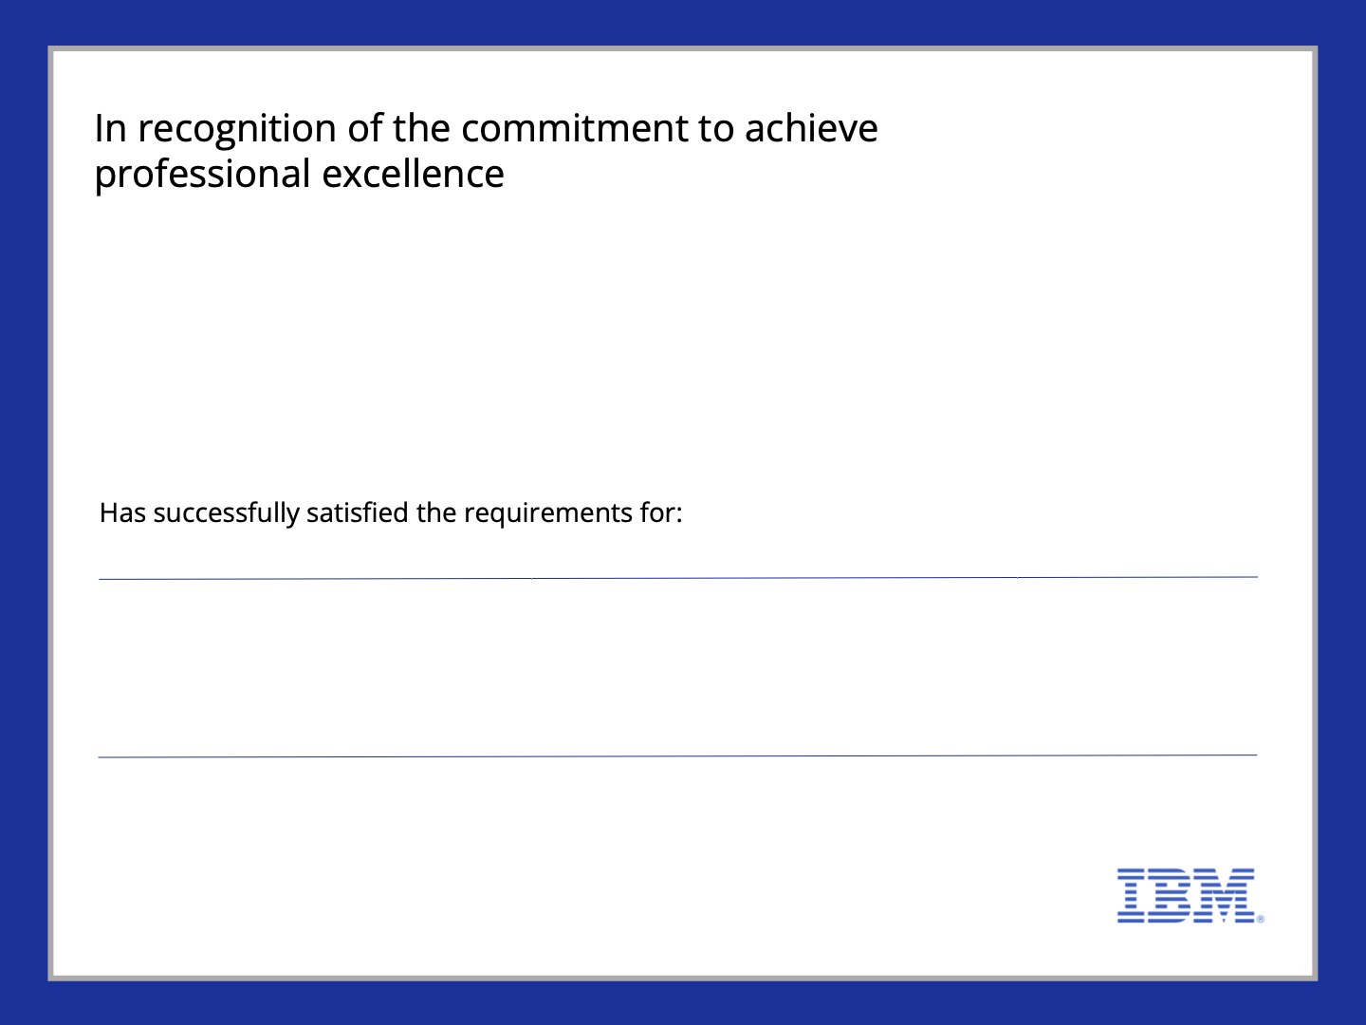
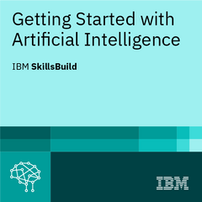

Sumangal Chhetri
Getting Started with Artificial Intelligence
Issued on:Jul21, 2025
Issued by:IBM SkillsBuild
Verify:
https://www.credly.com/badges/b0626f7d-a770-4ff3-8a92-e2fe753a5fb1

Slide 15
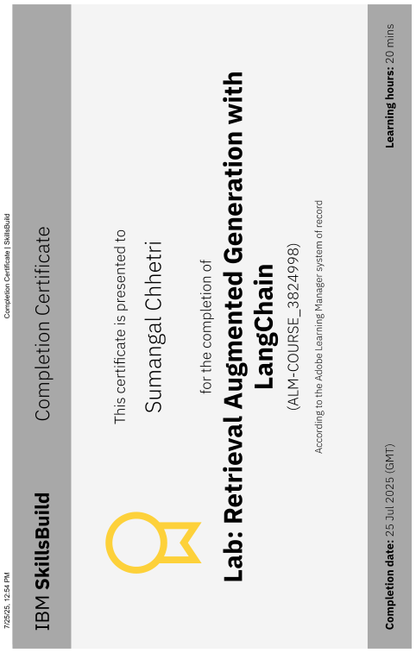

Slide 16
THANK YOU

